Slide 1
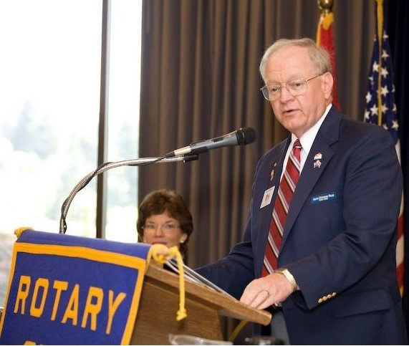
Brian Beagle – 44 Years in Silverdale Rotary – 3 of 3
Joined 1980
President 1985-86
D5020 Conference Co-Chair 2003
D5020 Area 9 Asst Governor 2003-2005
District Governor 2008-09
D5020 Foundation Chair 2009-2013
D5020 Rep - 2016 RI Council on Legislation

Slide 2
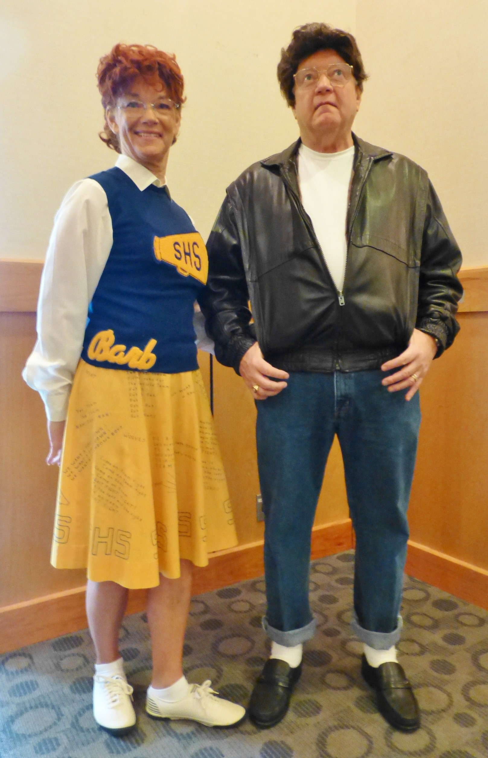
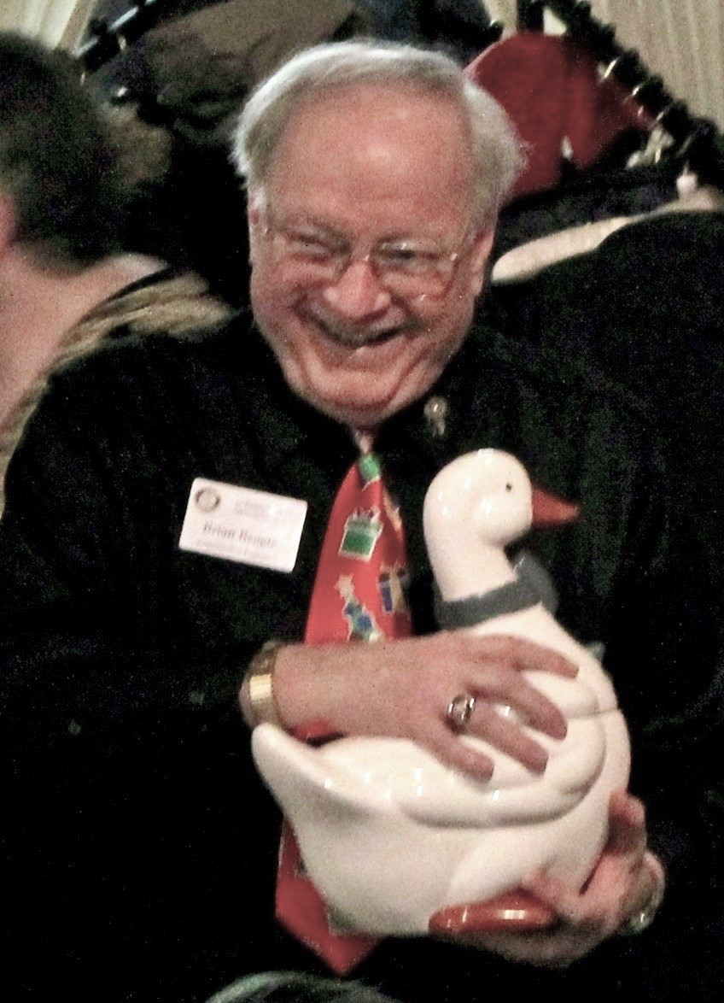
Fun!
You Can’t Have This Duck!

Slide 3
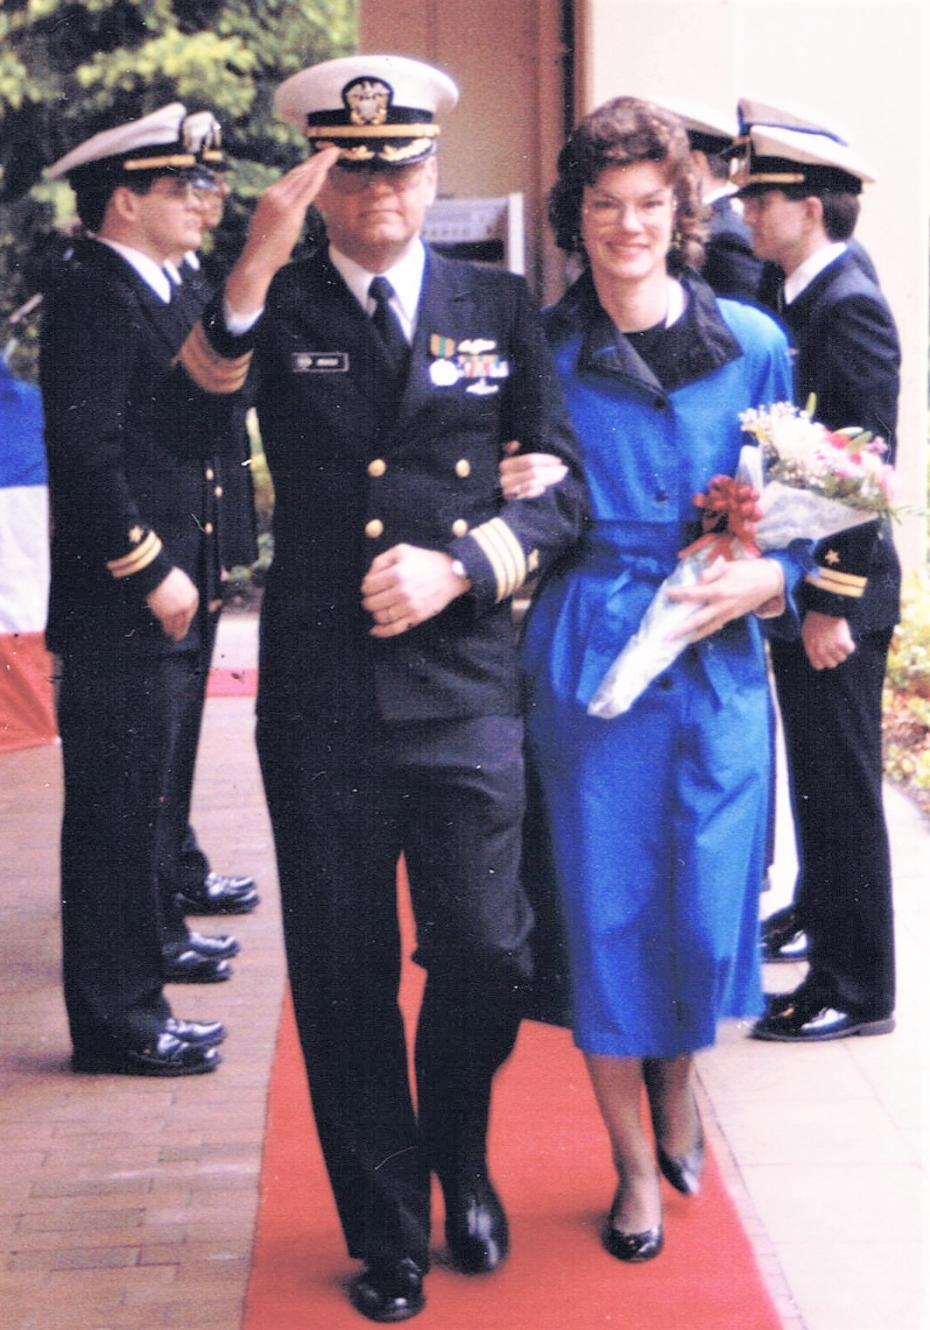
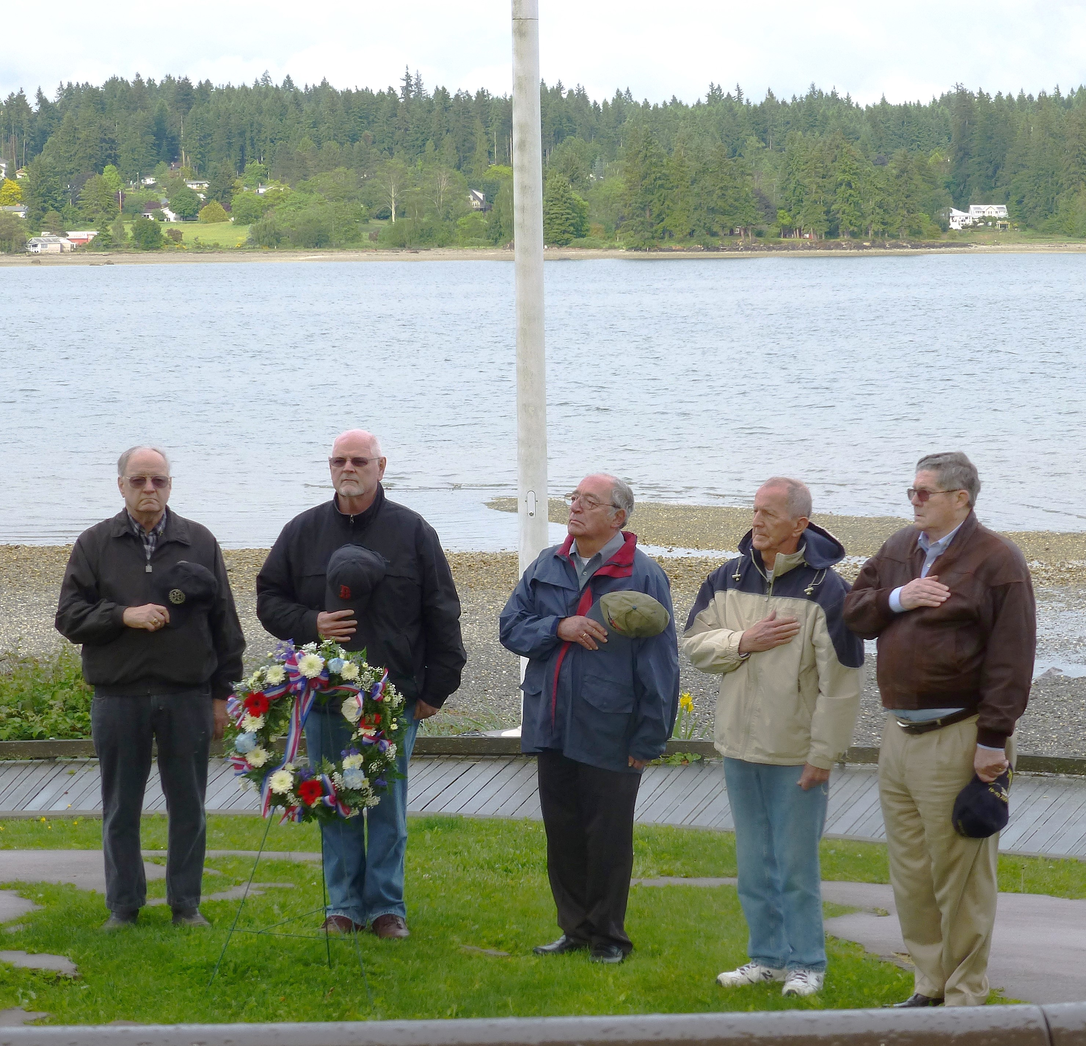
Proud Retired Navy Veteran

Slide 4
Silverdale Rotary Club
Thanks for the Memories!

Slide 5
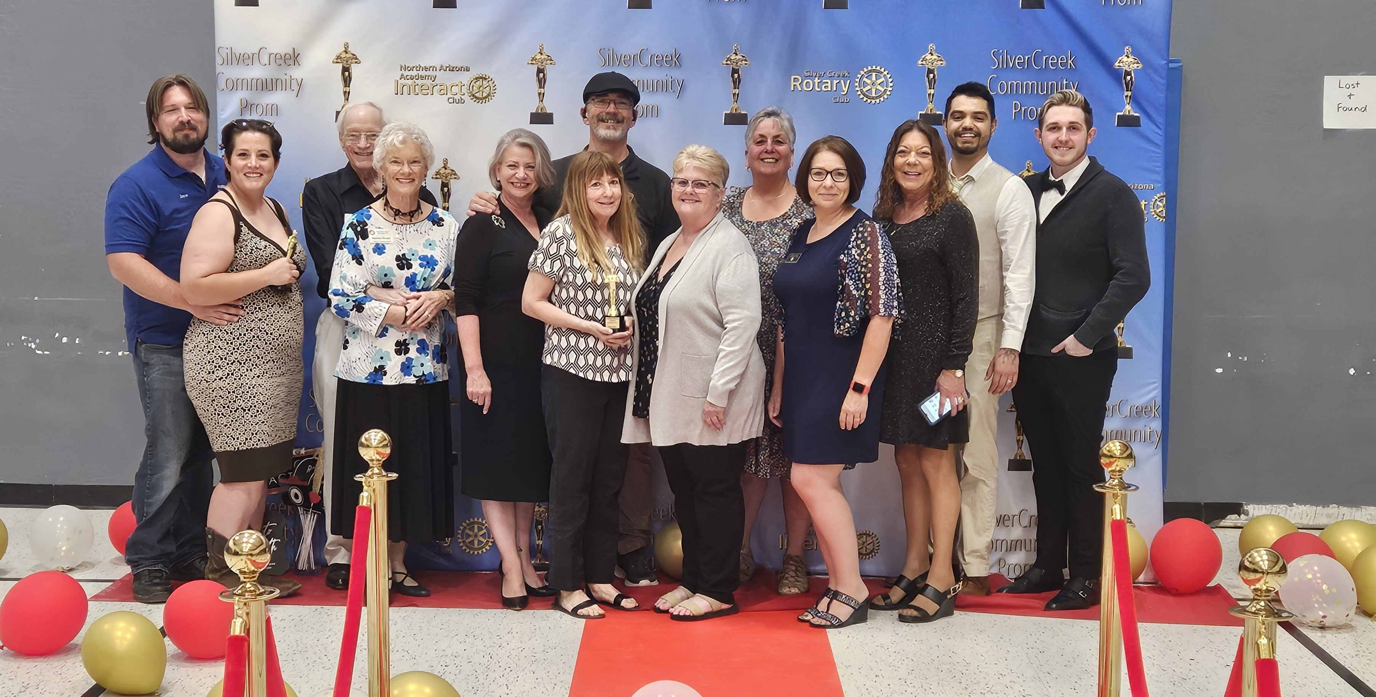
But Wait – There’s More!
Silver Creek Rotary Club - Snowflake, AZ

Slide 6
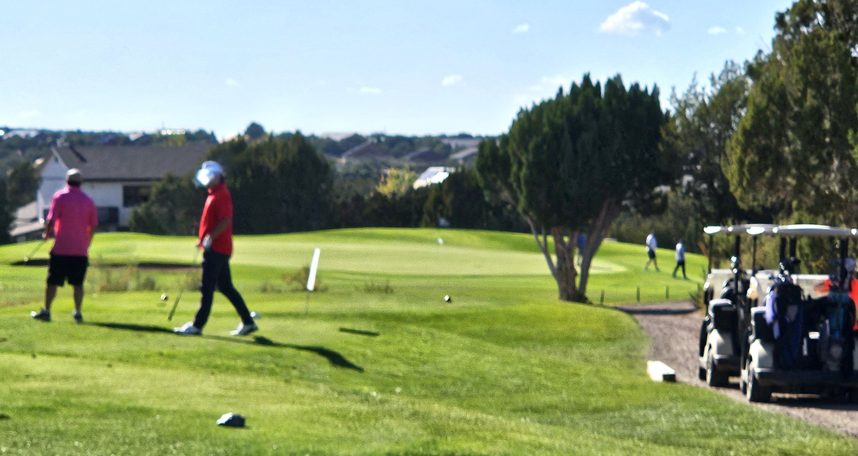
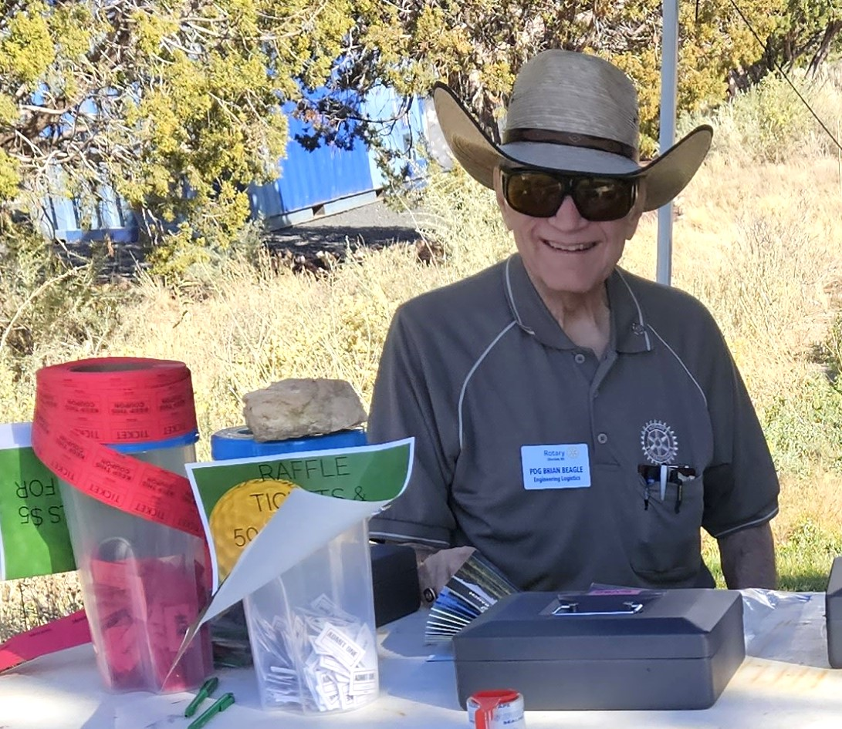
Golf Tournament Fund Raiser

Slide 7
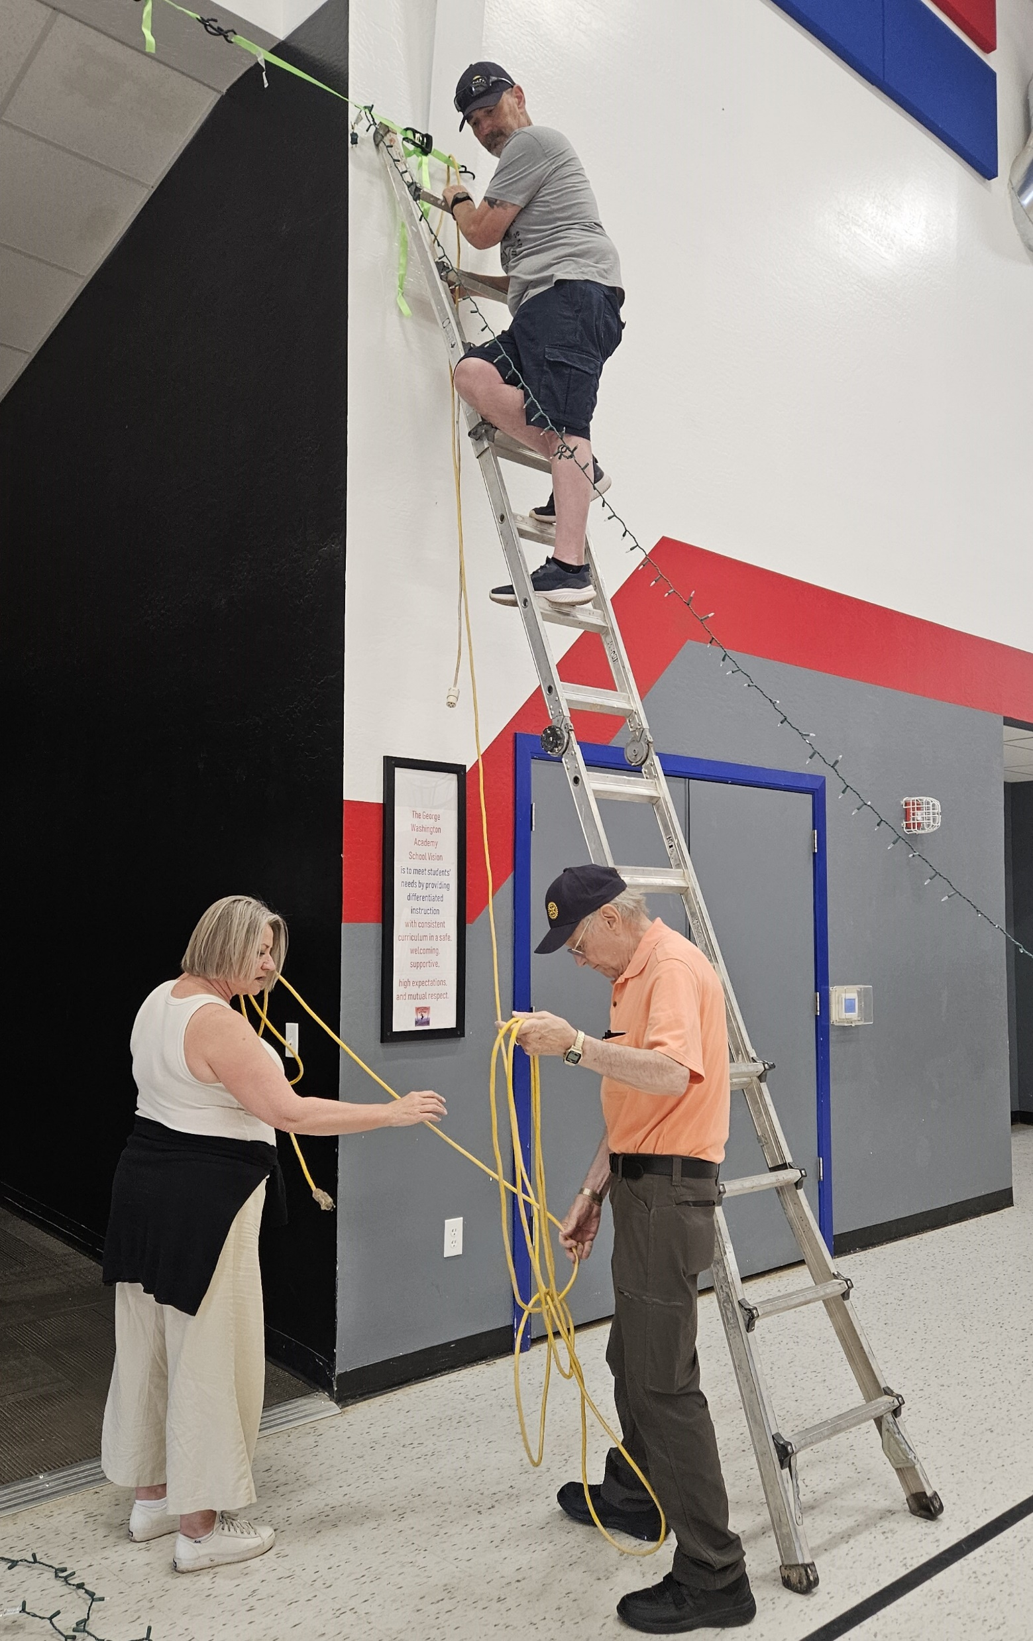
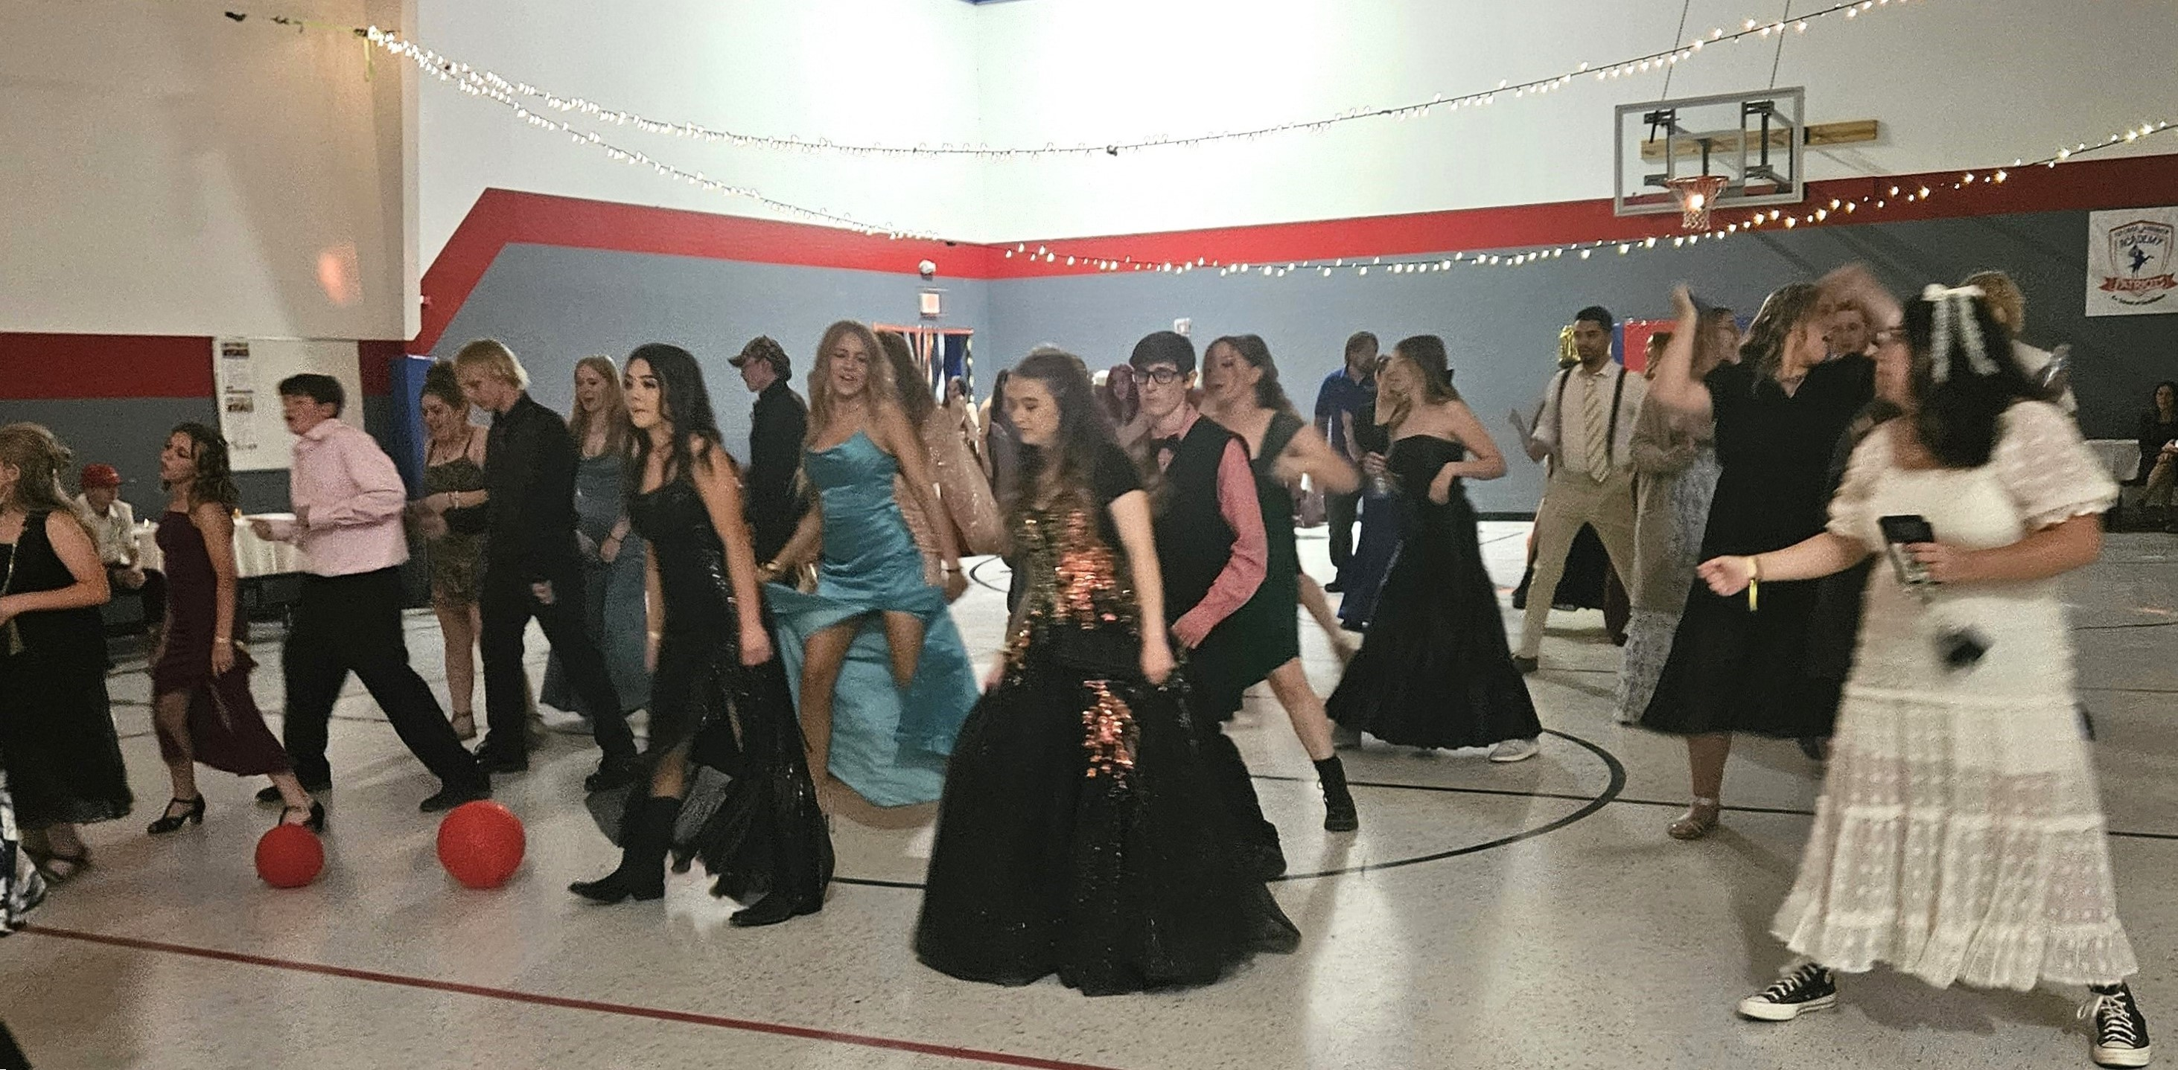
Community Prom Night with Interact Club

